Slide 1
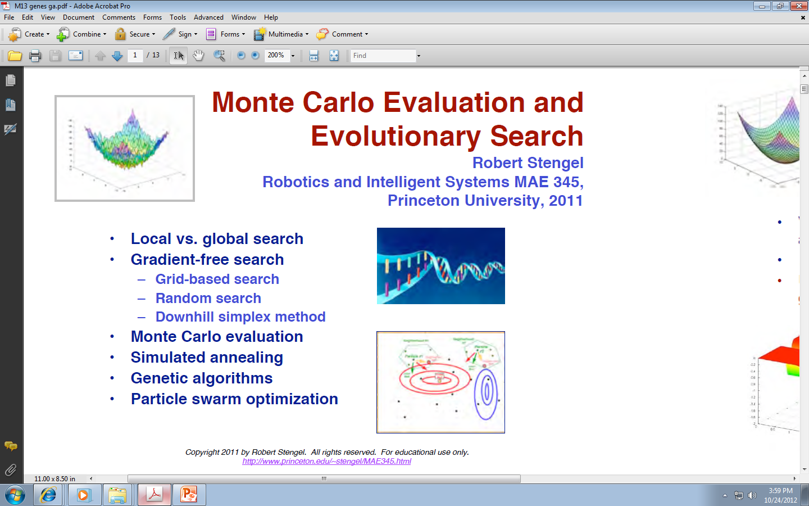
Monte Carlo Evaluation and Evolutionary Search

Slide 2
Jacobians are not a panacea!
Jacobian generalizes the derivative
Derivative/Jacobian to find best gradient for search
We use Jacobian to find the local minima lub maxima.
But what if we cannot find Jacobian?
We use numerical optimization methods
The cost function will be denoted by J and the point in n-dimensional space by u.

Slide 3
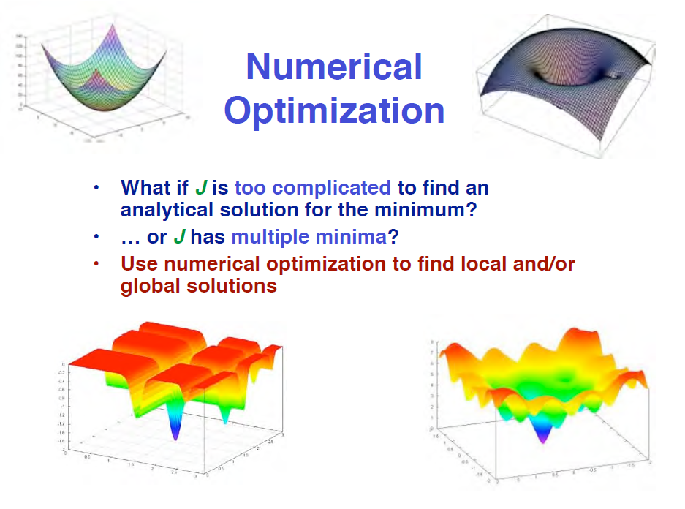

Slide 4
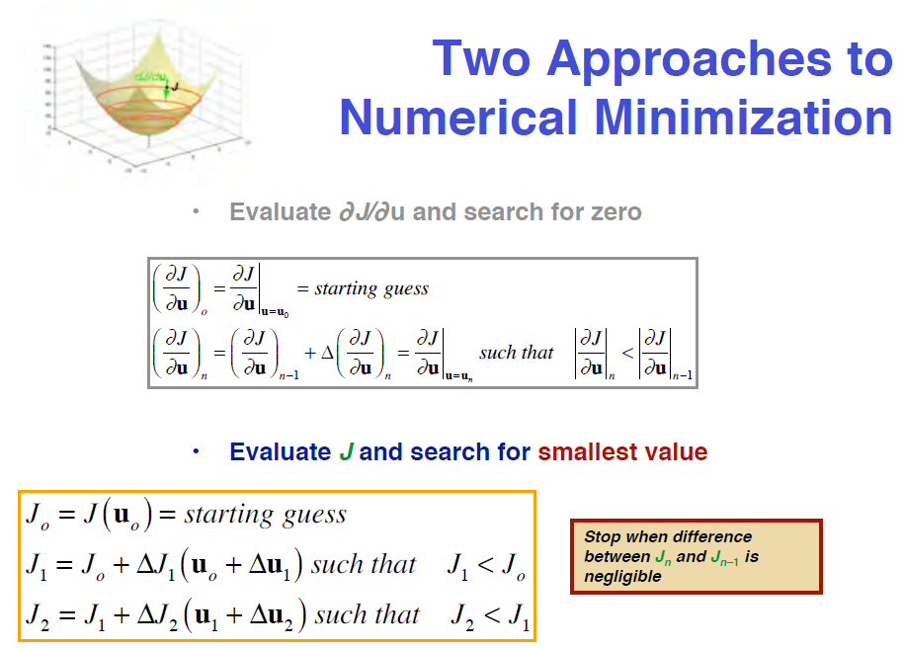
Here we calculate gradient
U is a point in n-dimensional space
Here we do not calculate gradient

Slide 5
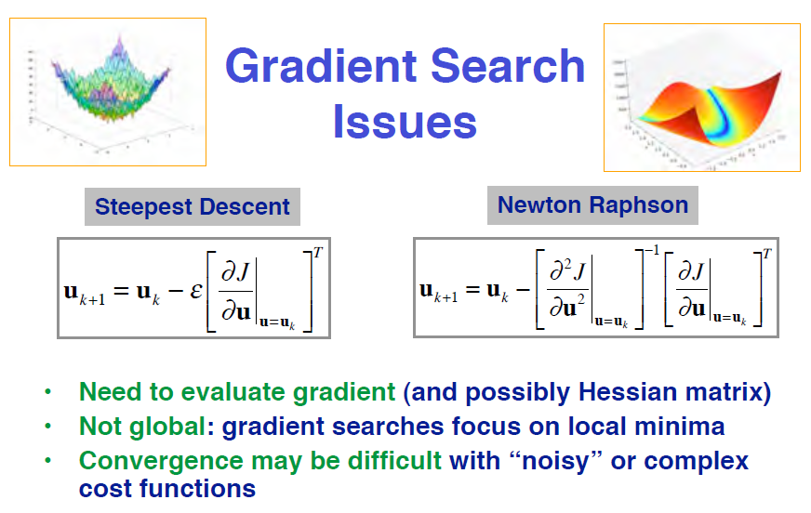
The search can be:
  Use Gradient
  Without gradient (regular grid or random grid)

Slide 6
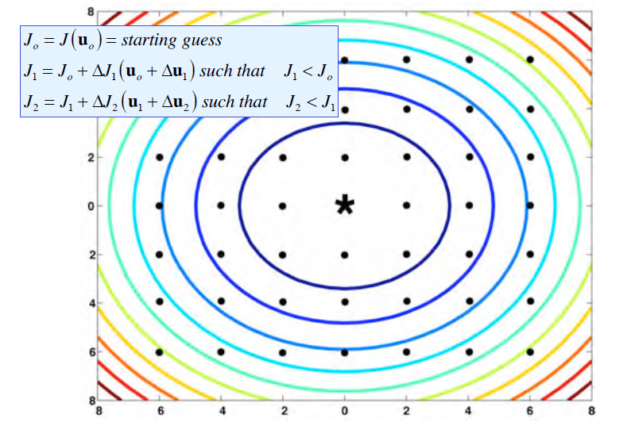
Gradient-Free Search:
Grid Based Search
Regular grid

Slide 7
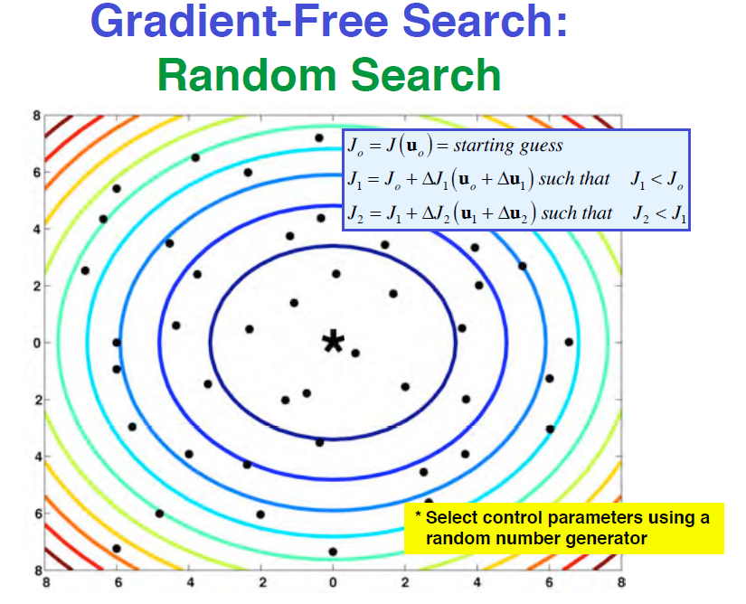
random grid

Slide 8
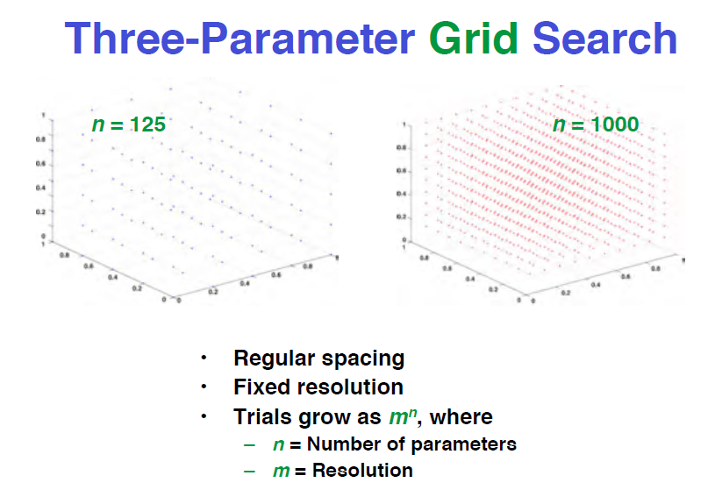
125=5*5*5
1000=10*10*10
The space is three-dimensional, just as an example here

Slide 9
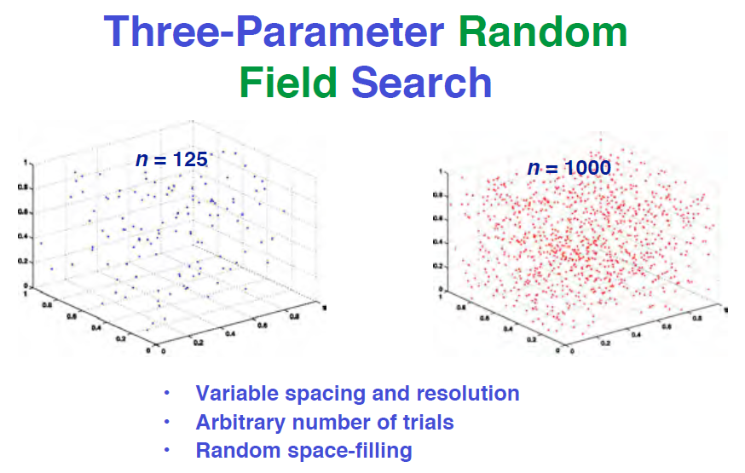
The space is three-dimensional in this particular example

Slide 10
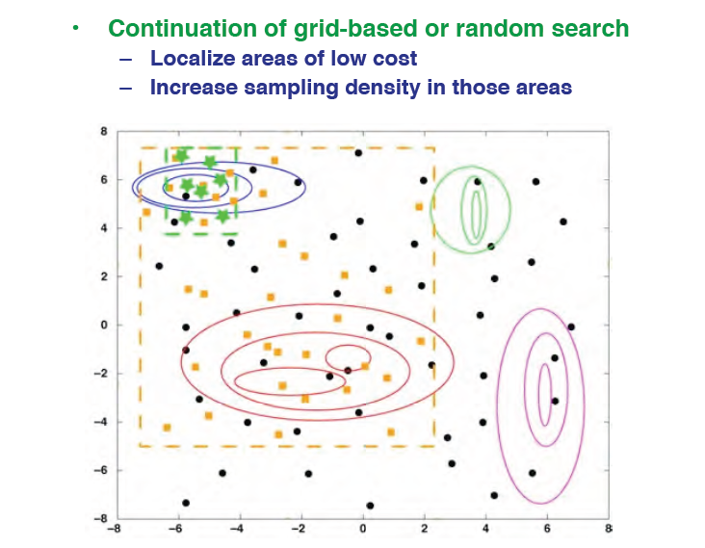
Directed (Structured) Search for Minimum Cost
Area of low cost

Slide 11
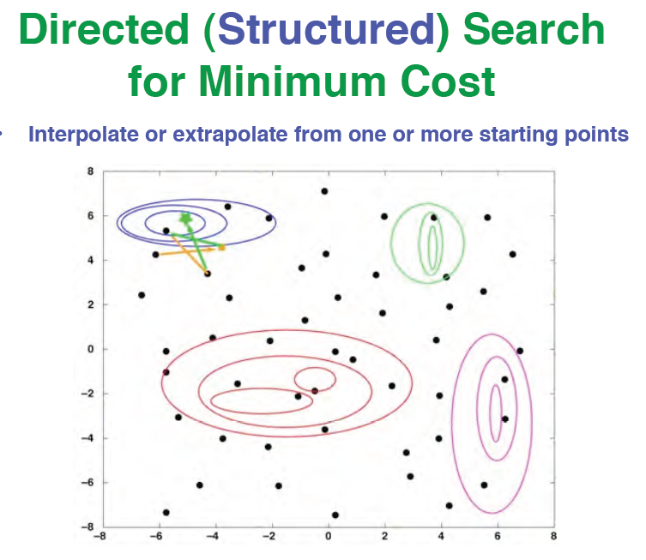
But question is “how to interpolate or how to extrapolate?”

Slide 12
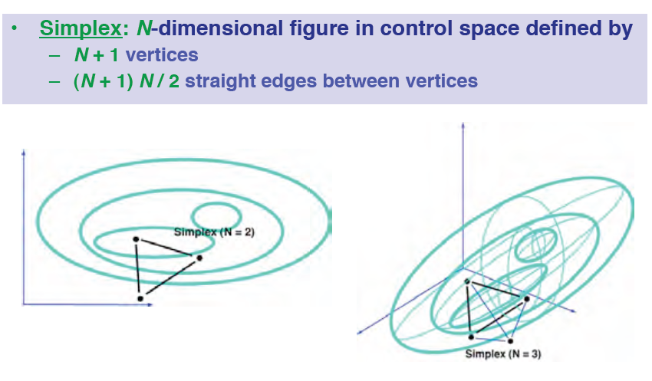
Downhill Simplex Search
Nelder-Mead Algorithm
Simplex has four vertices in 4-dimensional space
In this case N=2, space is two-dimensional so simplex has three vertices

Slide 13
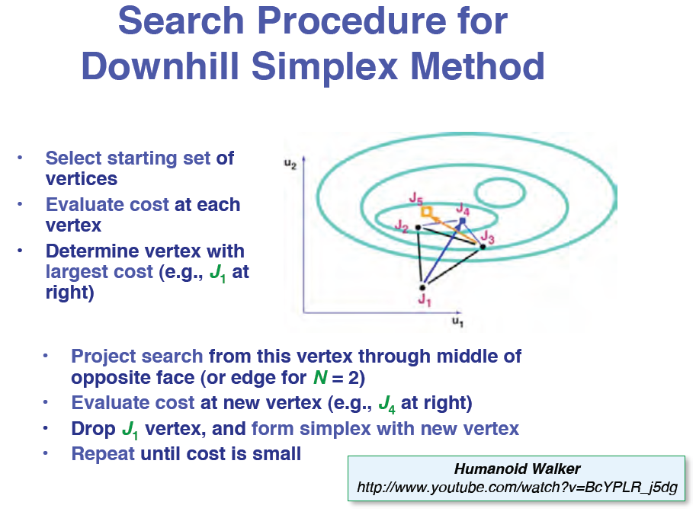

Slide 14
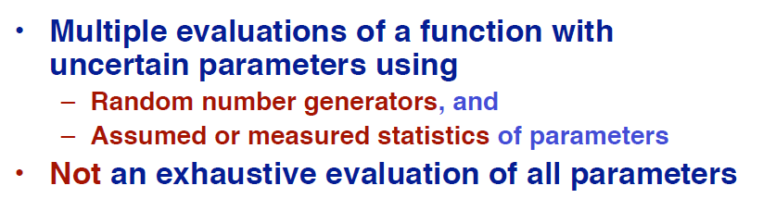
Monte Carlo Evaluation of Systems and Cost Functions

Slide 15
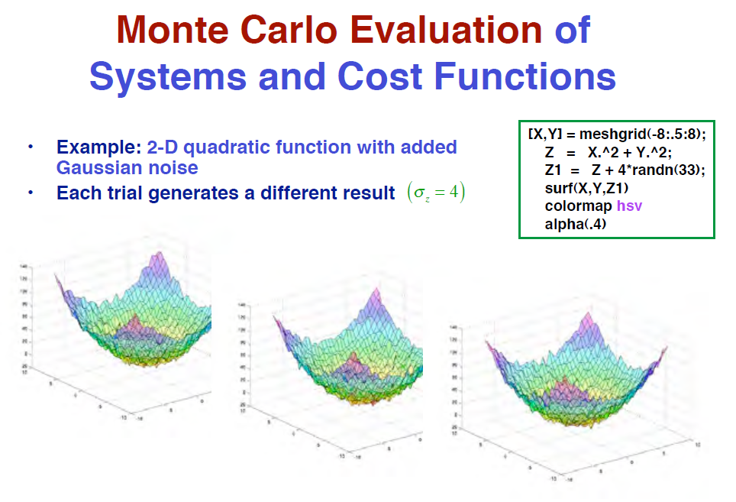
Finding THE global minimum may be not possible but coming close to it is much easier
Importance of good benchmark problems to compare various tools

Slide 16
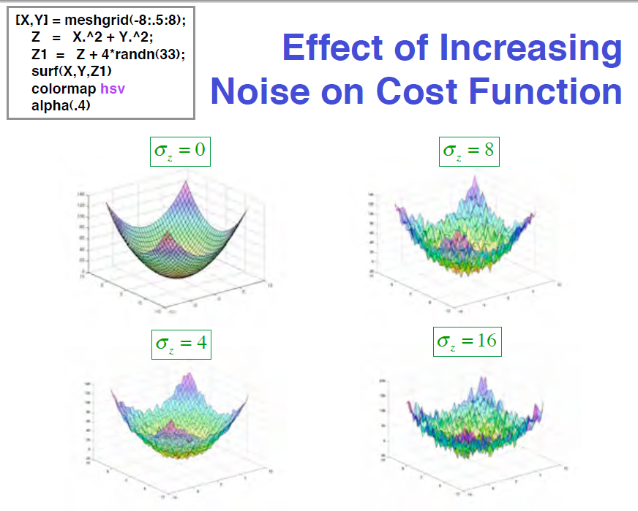

Slide 17
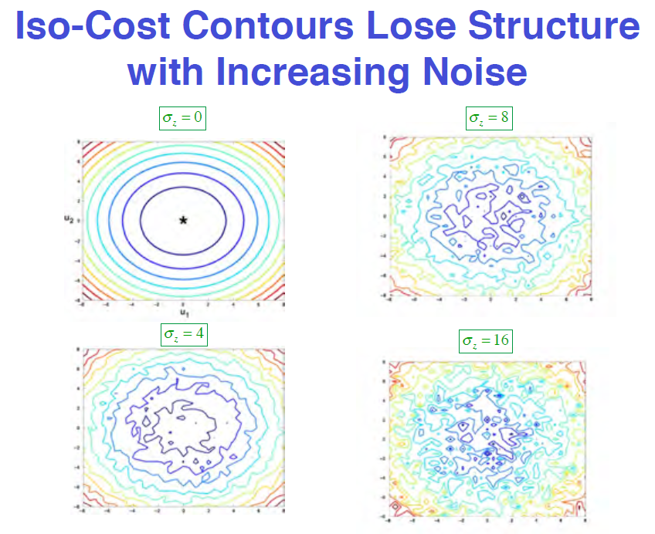
Two important concepts:
  Structure
  Iso-Cost contours

Slide 18
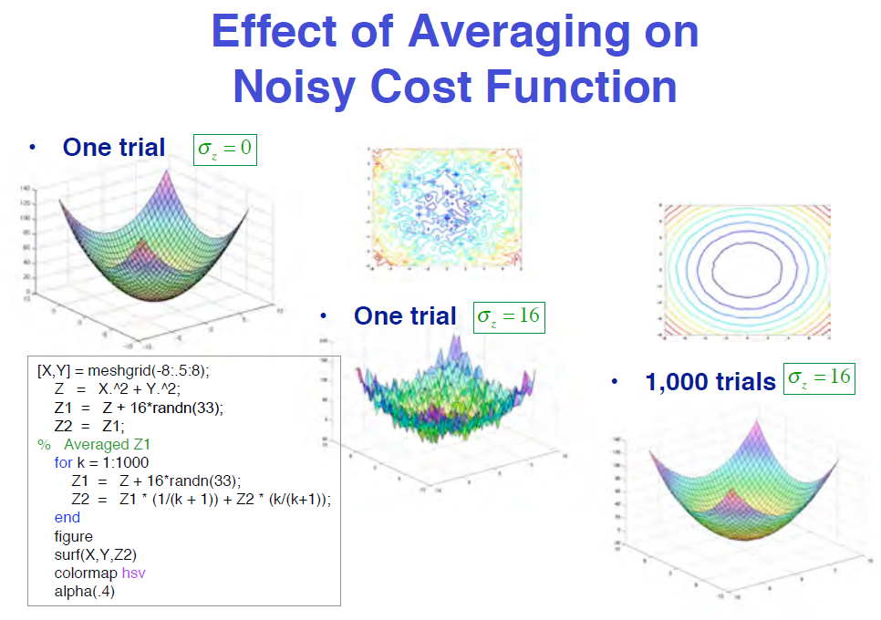
Averaging is the common trick here.
Check for various value of covariance/standard deviation

Slide 19
Estimating a probability of coin flip

Slide 20
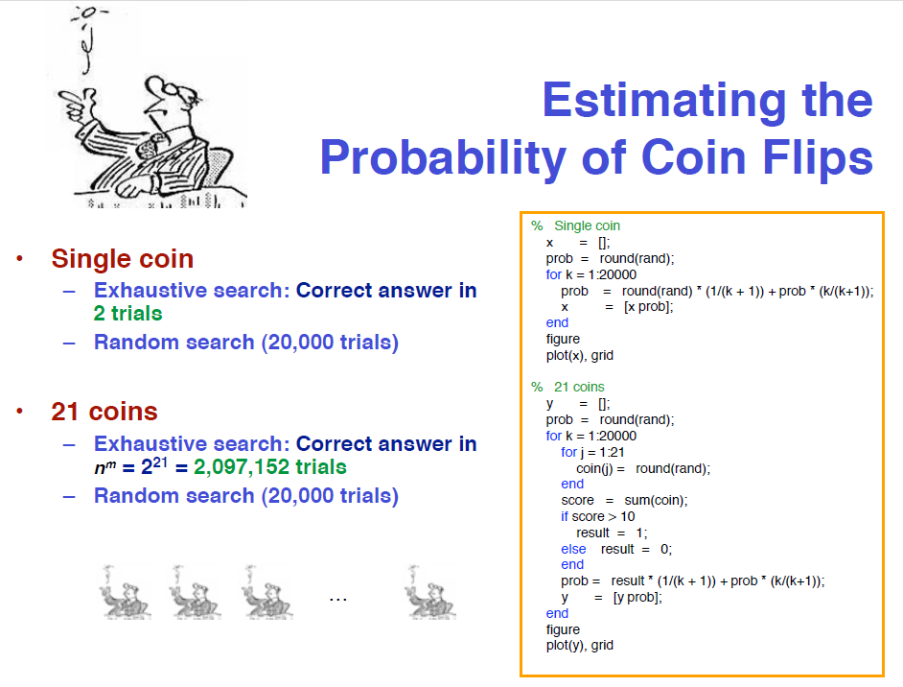
Random search

Slide 21
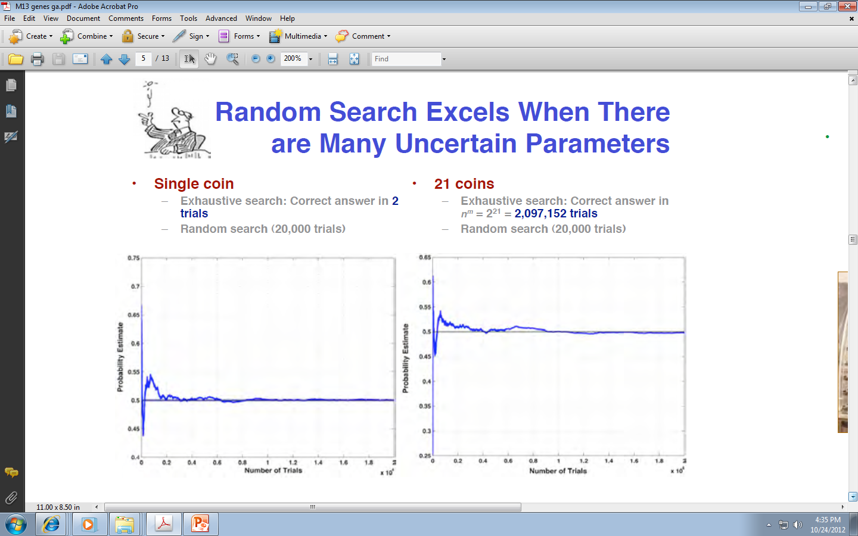
Random Search Exceeds when there are many uncertain parameters

Slide 22
Physical Annealing
Uses randomness

Slide 23
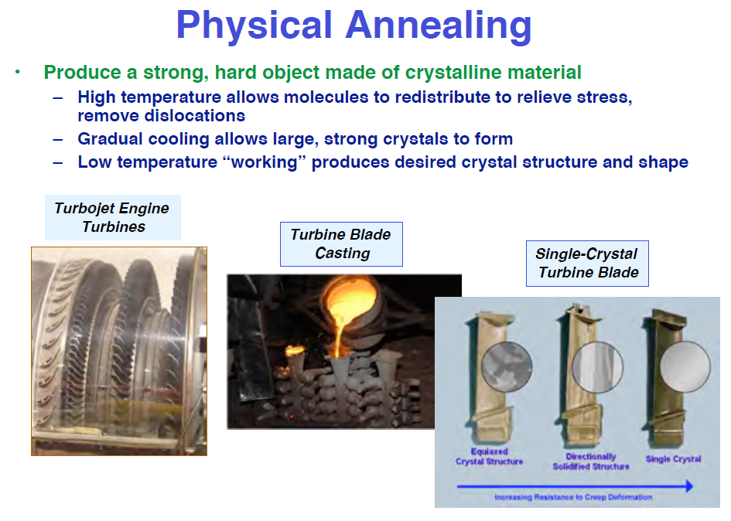

Slide 24
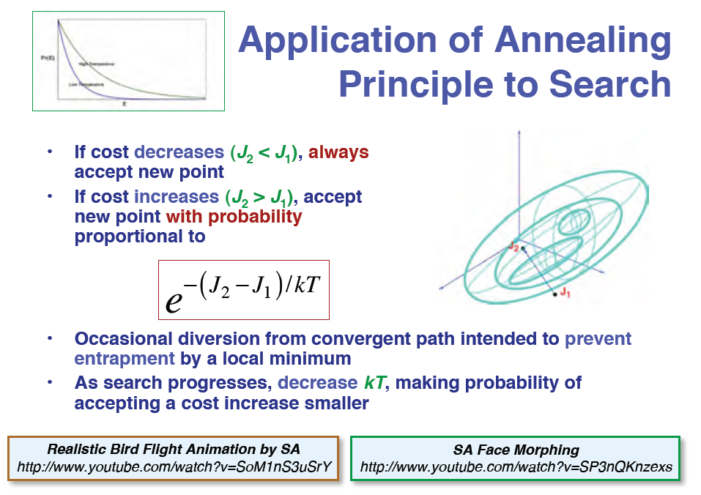

Slide 25
Combining Methods

Slide 26
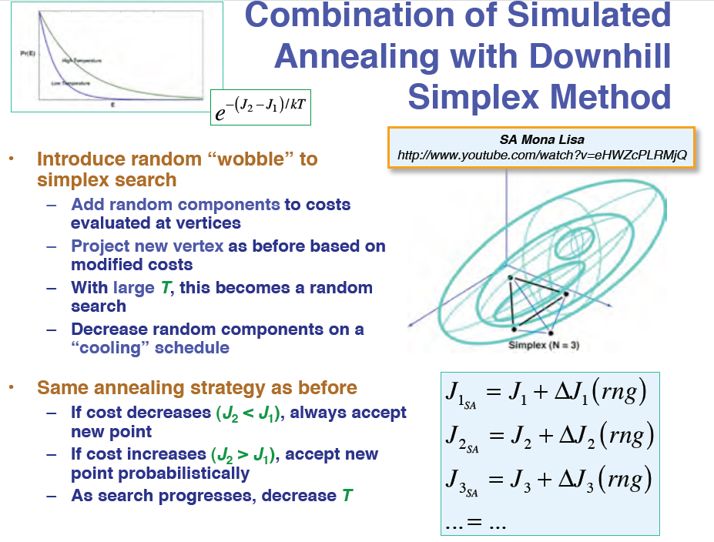

Slide 27
Genetic Algorithms

Slide 28
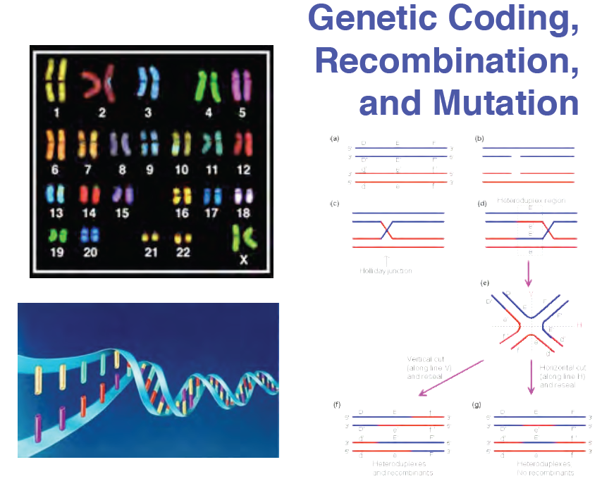

Slide 29
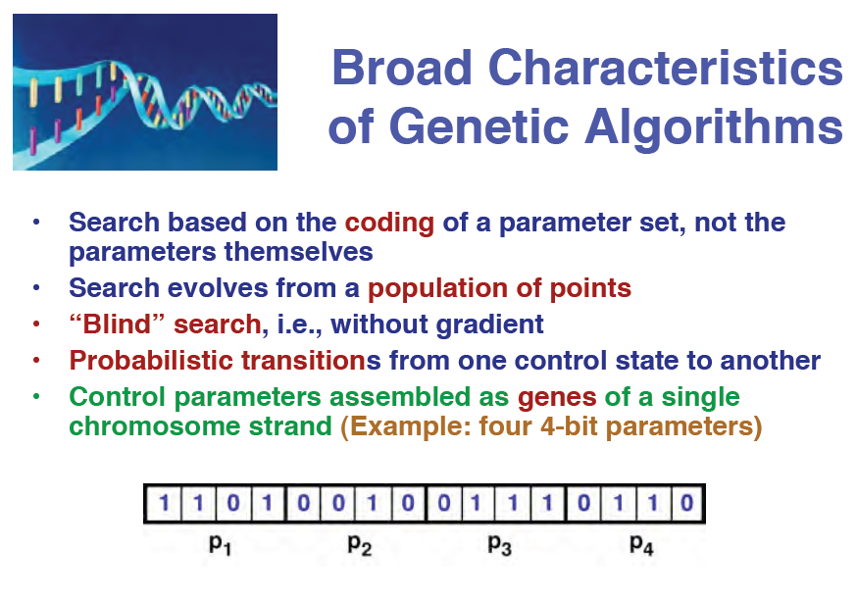

Slide 30
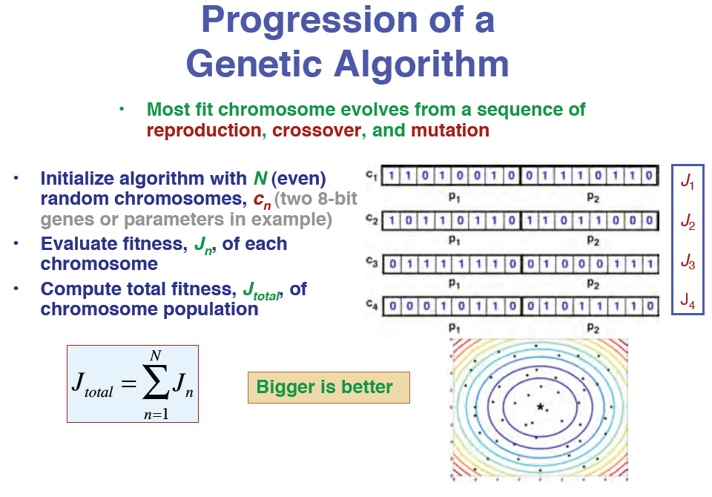

Slide 31
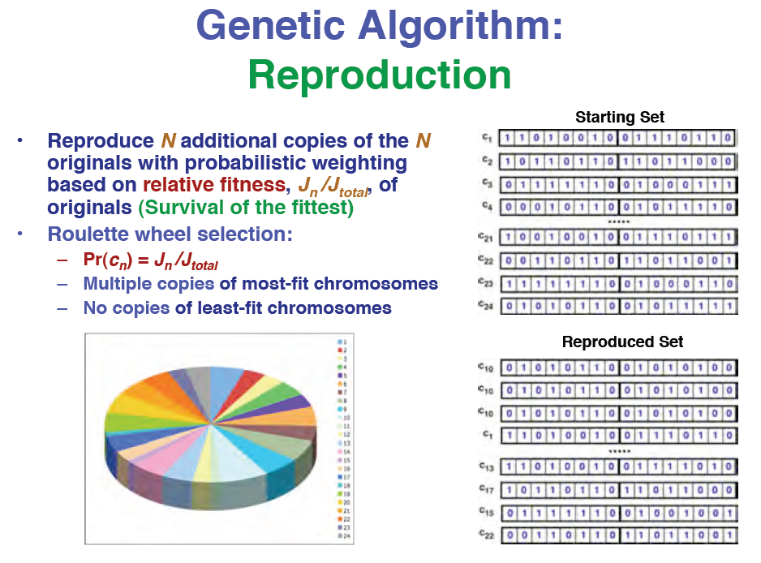

Slide 32
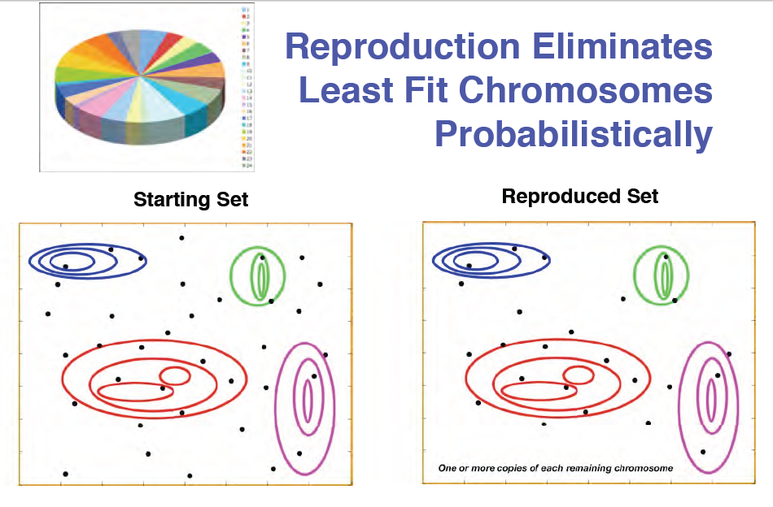

Slide 33
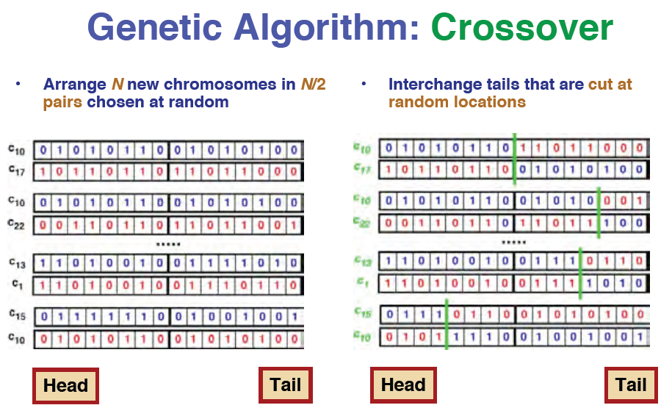

Slide 34
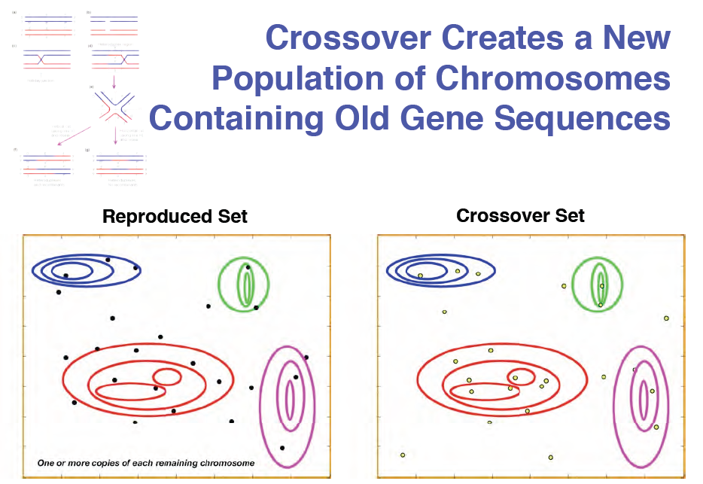

Slide 35
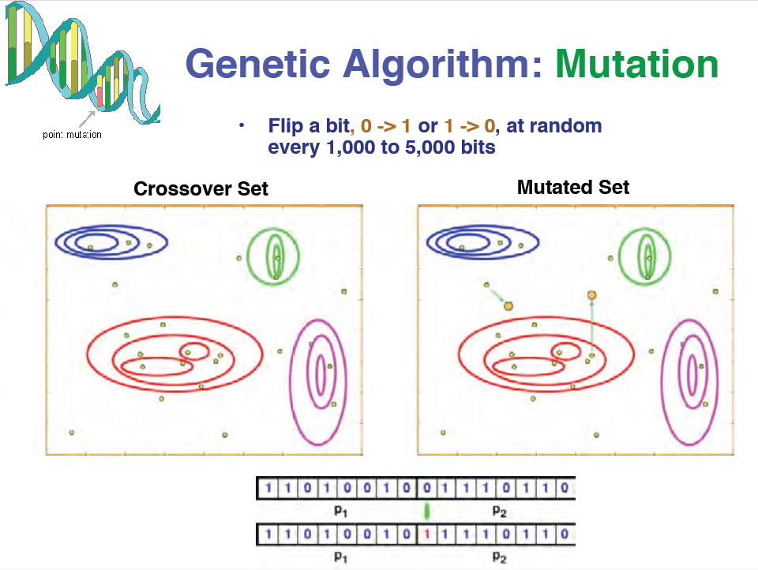

Slide 36
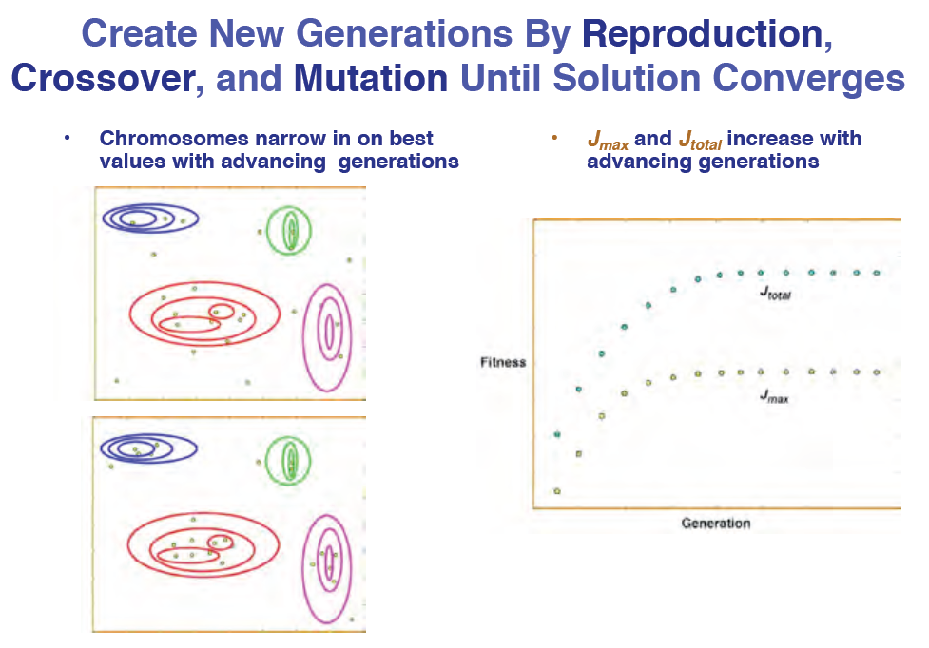

Slide 37
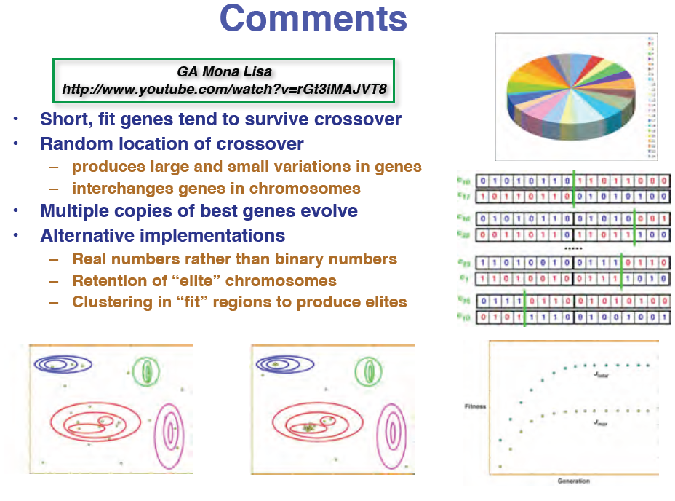

Slide 38
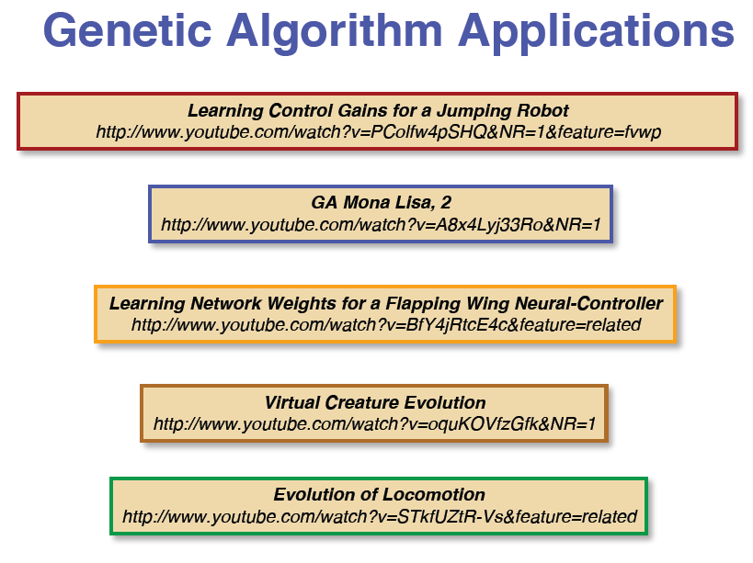

Slide 39
Comparison of SA, DS, and GA
Down hill simplex

Slide 40
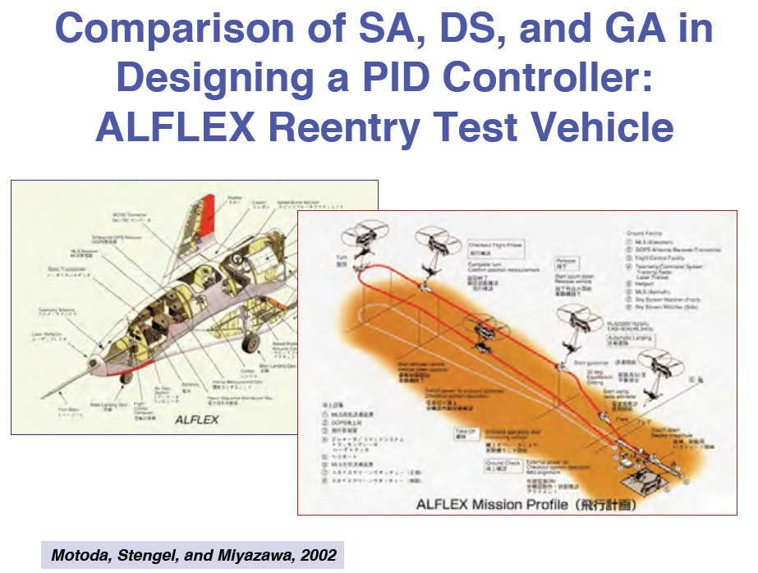
ALFLEX REENTRY TEST VEHICLE

Slide 41
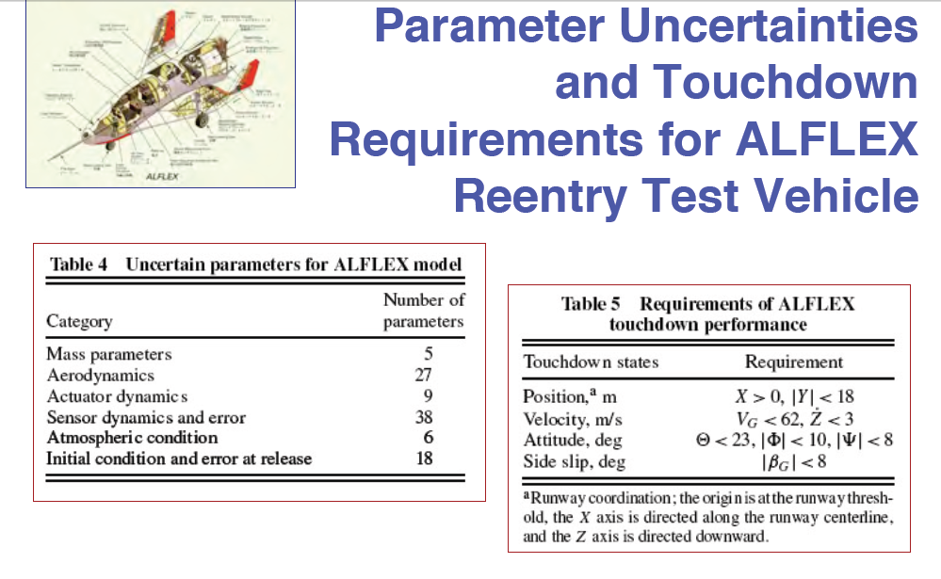

Slide 42
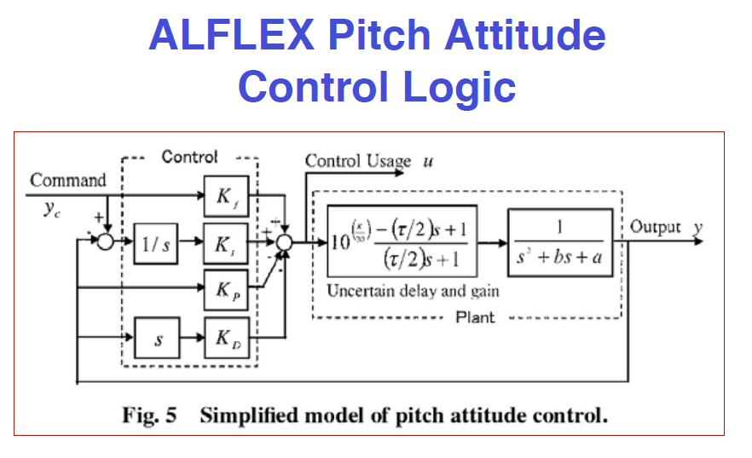

Slide 43
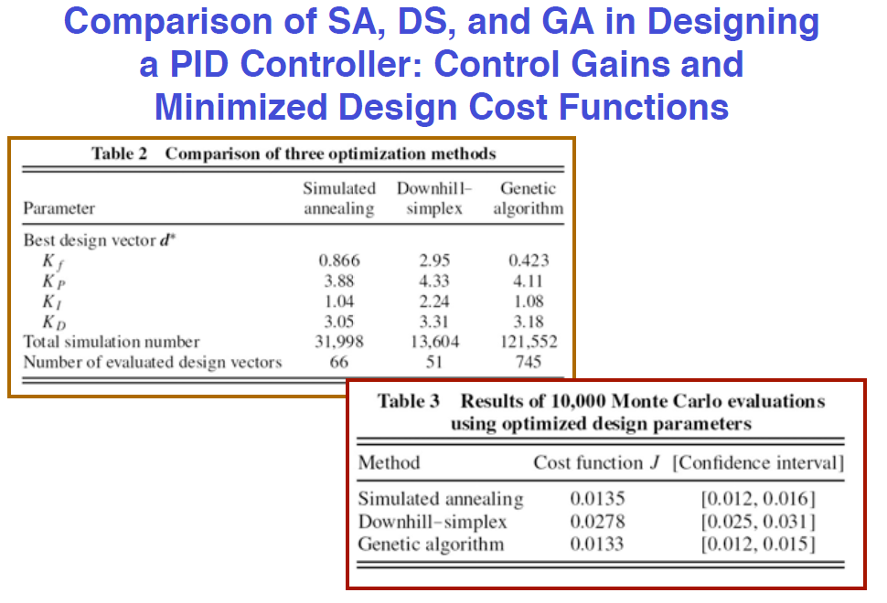
We want to find such parameters that the cost function reaches the smallest value

Slide 44
Particle Swarm Optimization

Slide 45
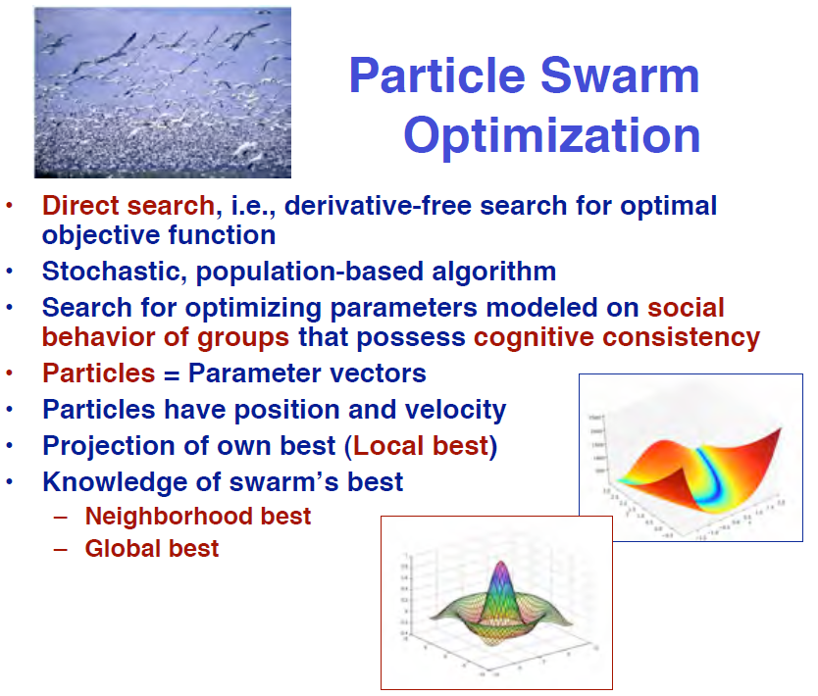

Slide 46
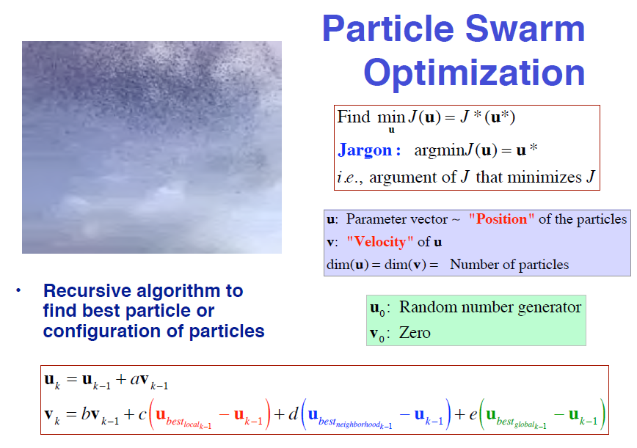

Slide 47
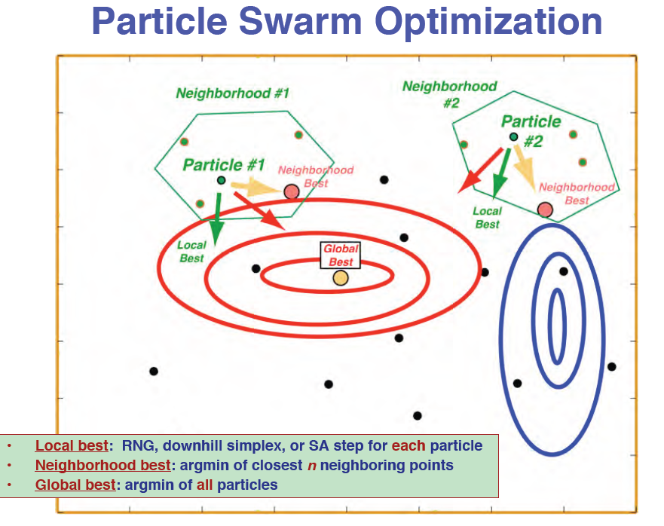
Random number generator

Slide 48
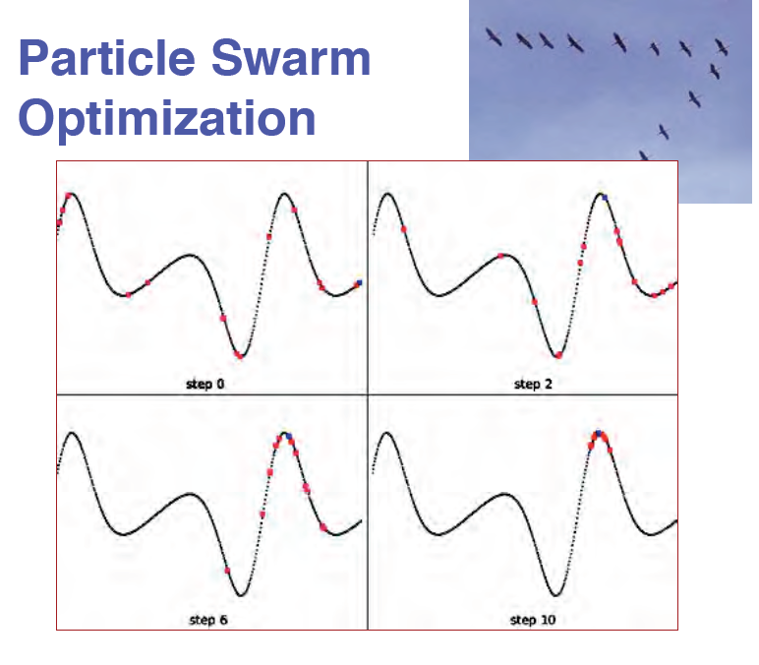

Slide 49
Examples of using particle swarm optimization

Slide 50
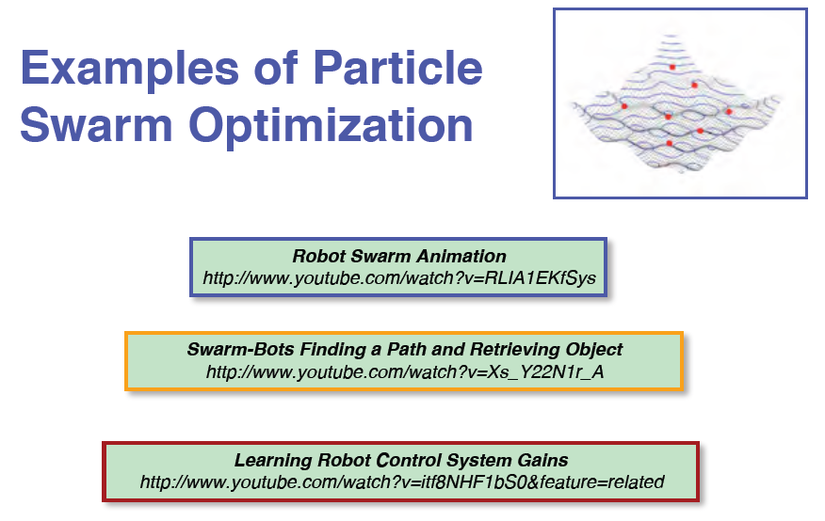

Slide 51
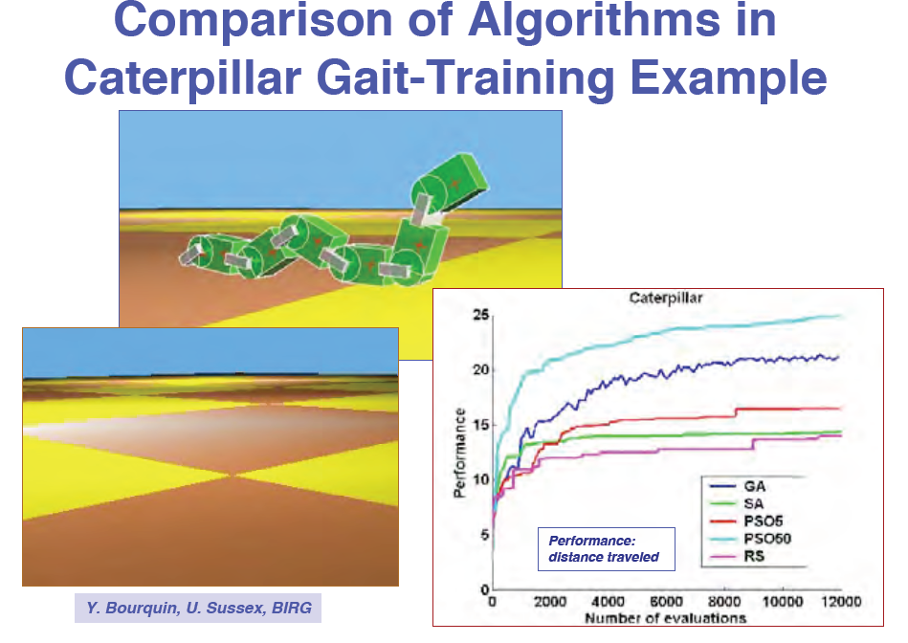
Example 1

Slide 52
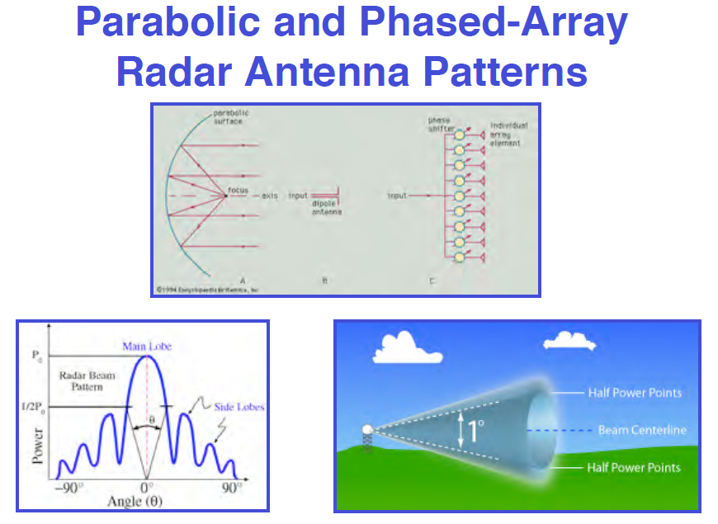
Example 2

Slide 53
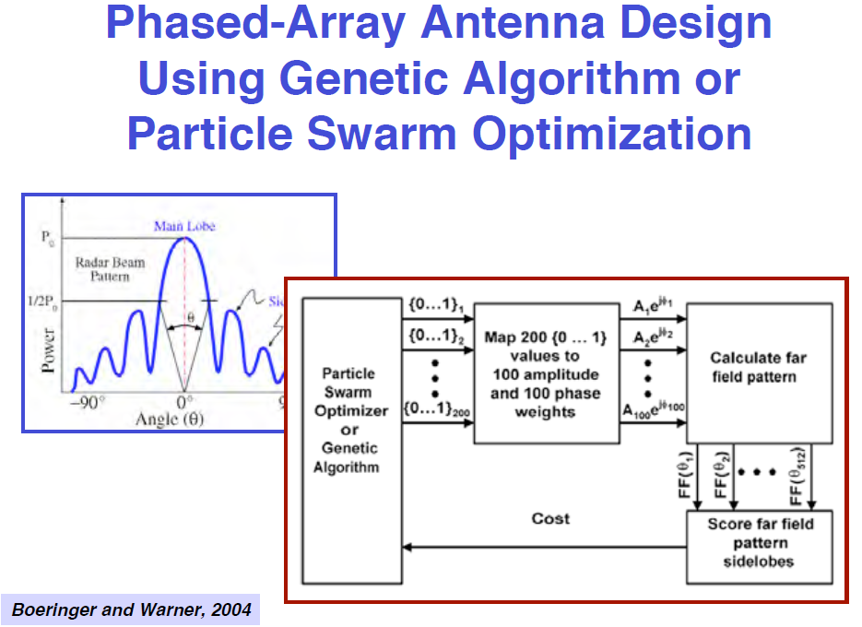
Example 2: GA or PSO

Slide 54
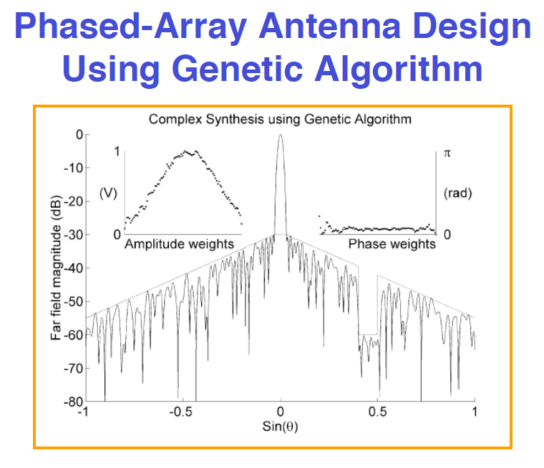
Example 2: GA

Slide 55
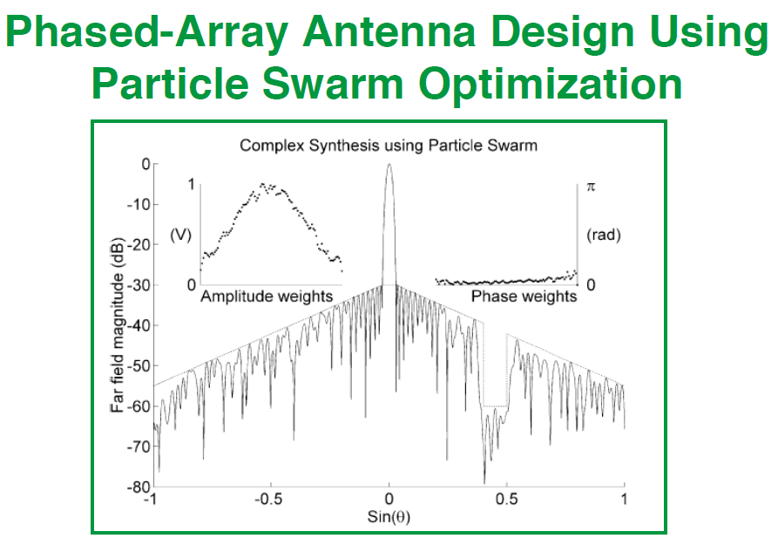
Example 2: PSO

Slide 56
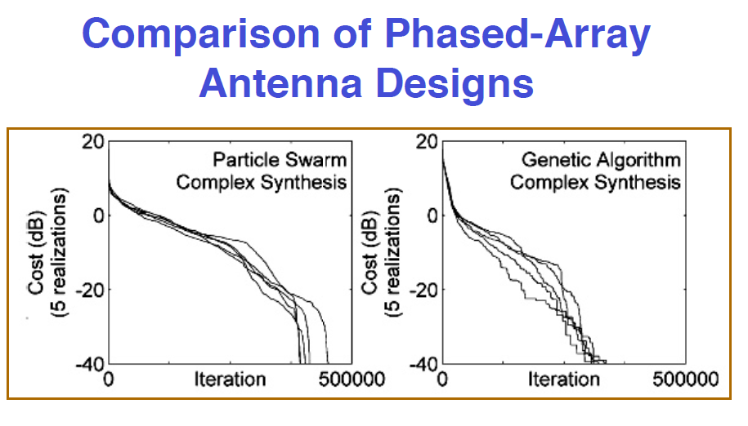
Example 2: compare

Slide 57
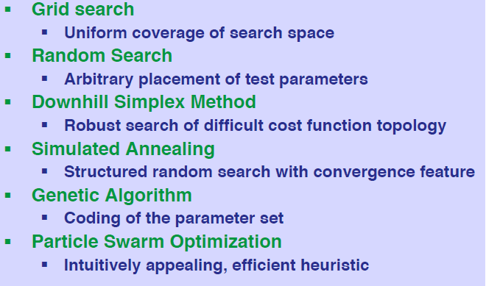
Summary of Gradient-Free Optimization Algorithms

